Slide 1












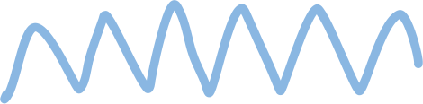

Major Project Presentation

Slide 2

Origin of the creative idea
This project presents a machine learning-based solution for real-time transcription and translation, addressing the critical needs of accessibility and multilingual communication in media. Utilizing a versatile user interface for handling both audio and video inputs, the system integrates advanced NLP techniques and transformer models to offer live captioning, speech synthesis, translation, and summarization. It achieves high accuracy in translations across multiple regional Indian languages through methods like topic extraction, bias detection, and recursive feature selection, all implemented on Google Colab with the transformers library for efficient processing. Cross-validation was employed to optimize key performance metrics—accuracy, latency, and language coverage—ensuring a reliable and inclusive solution. This robust framework addresses media inclusivity gaps and has applications in business, education, and accessibility programs. Additionally, the integration of bias detection and interpretable outputs promotes proactive decision-making, expanding information accessibility for a broader audience and enriching the user experience.

Slide 3
Vision: Develop an inclusive, real-time multilingual transcription and translation system that enhances accessibility for diverse audiences, bridging language barriers in media, education, and corporate environments.
01.
Project vision and mission
Mission: Leverage cutting-edge NLP and machine learning tools, such as Whisper, M2M100, and GTTS on Google Colab, to deliver accurate, context-aware captions, translations, and synthesized speech through a user-friendly interface for seamless audio and video processing.
02.
Impact: Promote an equitable information landscape by integrating functionalities like topic extraction, bias detection, and summarization, empowering users with transparent, reliable, and actionable insights across languages.
03.

Slide 4
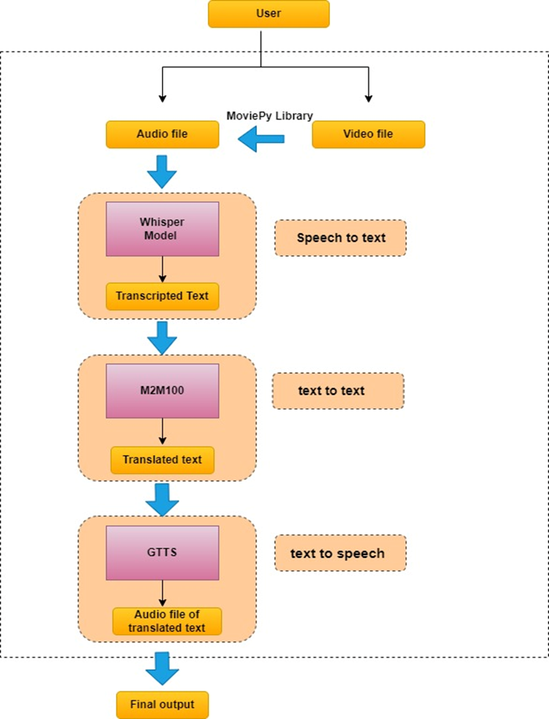

Slide 5
Ideation process
01
02
03
Speech to Text
Text to Text
Text to Speech

Slide 6
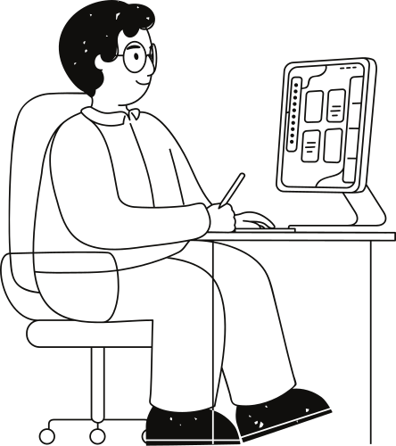
Speech to Text
In this project, we use the Whisper model by OpenAI to transcribe spoken language from audio and video sources into text. Whisper excels in capturing natural speech patterns and supports multiple languages, including regional Indian languages. By processing audio files directly on Google Colab, the model produces accurate, real-time transcriptions, allowing for an immediate written record of spoken content. This transcription is foundational to subsequent stages of translation and summarization, enabling seamless communication across language barriers and ensuring that spoken content can be easily understood in written form.

Slide 7
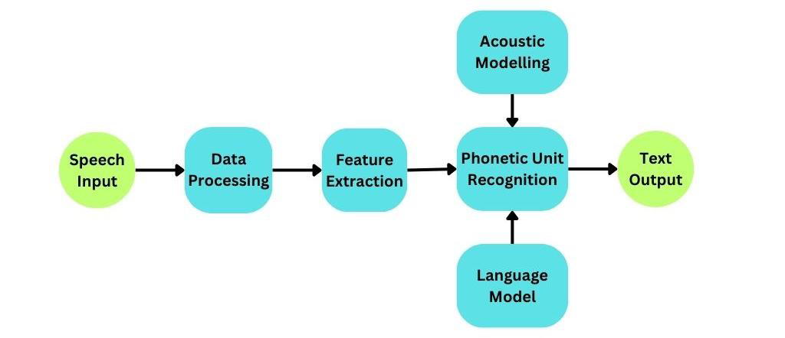
Speech to Text

Slide 8
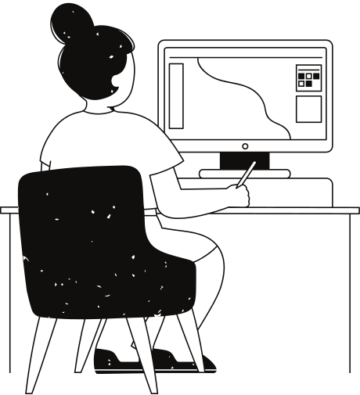
Text to Text
For translation, the project leverages the M2M100 model by Facebook AI, a robust multilingual model that facilitates direct translation between numerous language pairs without always requiring English as an intermediary. This allows translations to be accurate and contextually relevant, supporting Indian languages and others effectively. M2M100 enables the transcribed text to be converted into the target language chosen by the user, making information accessible in a range of languages. This feature not only enables multilingual captioning but also enriches the media experience by ensuring users from different linguistic backgrounds can fully understand the content.

Slide 9
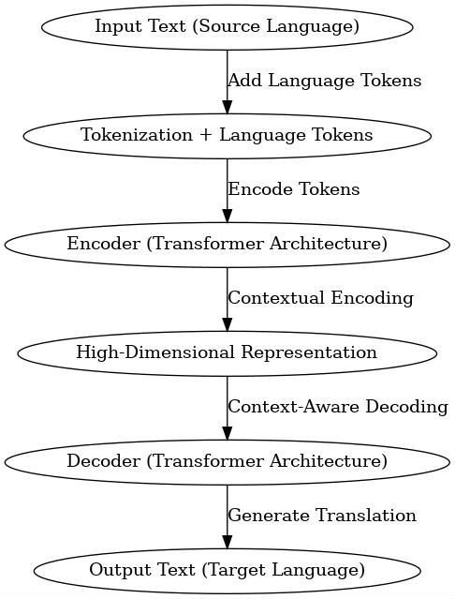
Text to Text

Slide 10

Text to Speech
Google Text-to-Speech (GTTS) is integrated to convert the translated and summarized text into spoken language. By using GTTS, the project provides audio renditions of the translated content in multiple Indian languages, catering to users who prefer auditory information or may have limited literacy in the target language. GTTS ensures that content can be delivered in a user’s preferred format, either as text or as synthesized speech, promoting accessibility for individuals across educational, linguistic, and accessibility needs. This feature enhances inclusivity and provides a comprehensive user experience by combining visual and auditory information outputs.

Slide 11
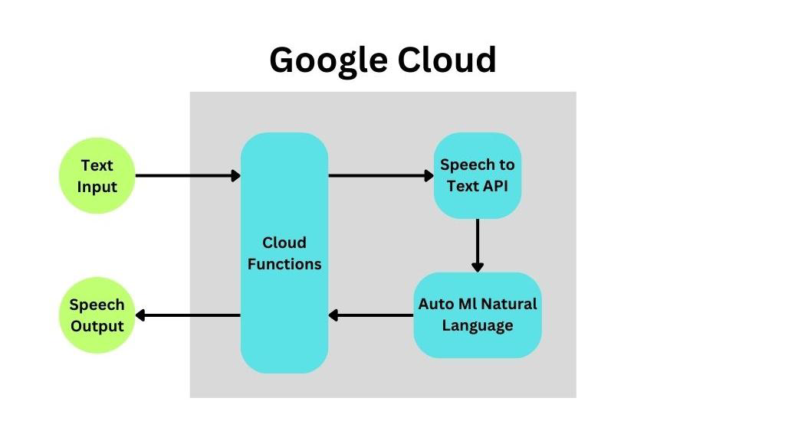
Text to Speech

Slide 12
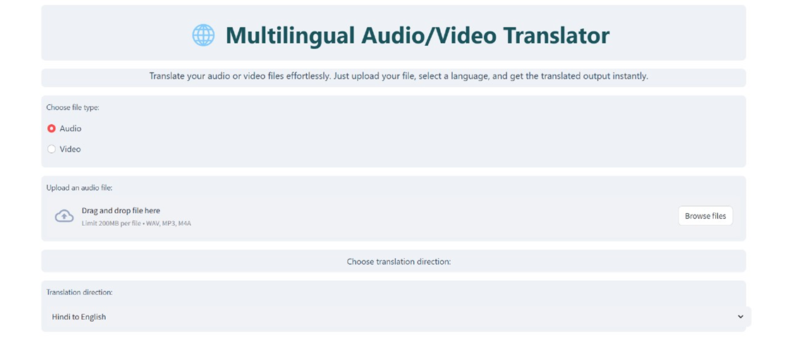

Slide 13
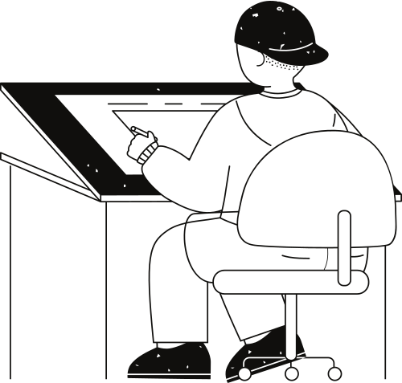
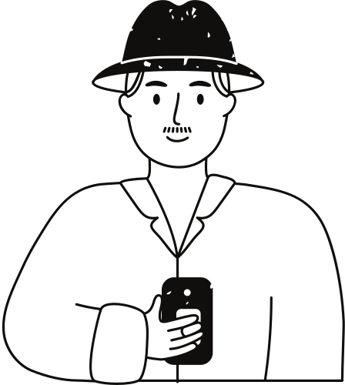




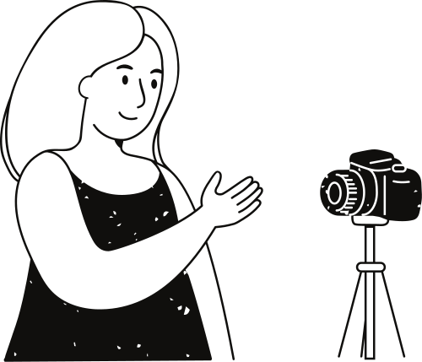
The Bilingual Language Translation Transcribing System addresses language barriers by offering real-time audio/video translations and summarizations, fostering inclusivity in education, business, and media.
Expanded Language Support: Incorporate more regional languages and dialects to enhance inclusivity and cater to underrepresented communities.
Conclusion & Future Scope
It ensures seamless communication across demographics, providing a user-friendly interface to interact with multilingual content for enhanced learning and accessibility.
Enhanced Accuracy & User Customization: Improve transcription and translation precision through adaptive learning and user-defined settings like language, summary length, and voice options.
By empowering economically disadvantaged communities with accessible tools, the project advances equitable access to information and promotes global collaboration.
Platform Integration & Scalability: Integrate with social media, learning platforms, and conferencing tools while optimizing for performance and scalability to meet growing user demand.

Slide 14
Thank you very much!

